Slide 1
Chapter 14
Medicare

Slide 2
Medicare
Largest medical program in United States
Federal program administered by CMS
CMS responsible for:
  Operation of Medicare program
  Selecting Medicare administrative contractors (MACs) to process claims for Medicare fee-for-service:
    Part A
    Part B
    Durable medical equipment (DME)

Slide 3
Medicare Prescription Drug, Improvement, and Modernization Act of 2003 (MMA)
Created Medicare administrative
contractors (MACs), which:
  Replaced carriers and fiscal intermediaries
  Process both Medicare Part A and Part B claims

Slide 4
Medicare Eligibility
General Medicare eligibility rules include:
  Individuals/spouses who have worked at least 10 years
  in Medicare-covered employment
  Individuals who are minimum of 65 years old
  Individuals who are citizens or permanent residents
  of United States
  Individuals also qualify for coverage if younger than 65
  and have a disability or end-stage renal disease (ESRD).

Slide 5
Medicare Part A Eligibility
Individuals age 65 and over who:
  Receive Social Security or Railroad Retirement Board (RRB) retirement benefits
  Are eligible to receive Social Security or RRB benefits but have not yet filed for them
  Had Medicare-covered government employment
Individuals under age 65 who have:
  Received Social Security or RRB disability benefits for 24 months
  End-stage renal disease and meet certain requirements

Slide 6
Medicare Eligibility Information
Electronic data interchange (EDI)
  Most efficient and cost-effective method of inquiry
  Provider agreements ensure privacy safeguards
Telephone inquires
  Verification of provider’s name and identification number required
  Information obtained about beneficiary:
    Last name and first initial
    Date of birth
    HICN (health insurance claim number)
    Gender

Slide 7
Medicare Enrollment
Enrollment is handled one of two ways:
  Individuals are enrolled automatically, or
  Individuals apply for coverage.
Individuals 65 and over do not pay monthly premium for Medicare Part A if they or spouse paid Medicare taxes while working.
Medicare Part B premiums based on modified adjusted gross income reported on an individual or joint tax return

Slide 8
Automatic Enrollment
Individuals not yet age 65 who already receive Social Security, RRB, or disability benefits are:
  Automatically enrolled in Medicare Part A and Medicare Part B
  Effective the month of their 65th birthday
(continues)

Slide 9
Automatic Enrollment
(continued)
Individuals who do not receive Social Security, RRB, or disability benefits must:
  Apply for Medicare Part A and Part B three months before the month in which they turn 65 or the 24th month of disability
Upon applying for Medicare Part A and Part B, a seven-month initial enrollment period (IEP) begins.

Slide 10
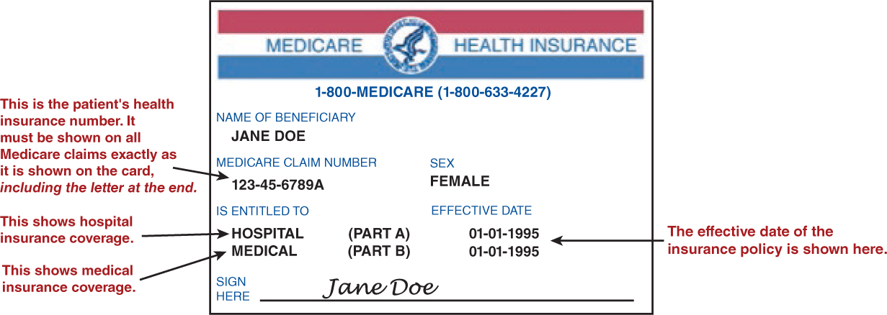
Sample Medicare Card

Slide 11
Automatic Enrollment
(continued)
Individuals who:
  Want both Medicare Part A (hospital insurance) and
  Medicare Part B (supplemental medical insurance) sign
  Medicare card and keep it in a safe place
  Do not want Medicare Part B coverage (because there is
  monthly premium associated with it) must follow
  instructions that accompany Medicare card
    Instructions direct individual to mark an “X” in the refusal box
    on the back of the Medicare card form, sign the form, and return
    it with the Medicare card to the address indicated.
    Individual is then sent a new Medicare card showing coverage
    for Part A only.

Slide 12
Applying for Medicare
Individuals who do not receive Social
Security, RRB, or disability benefits must
apply for Medicare coverage.
Initial enrollment period (IEP)
  Provides opportunity for enrollment in Medicare
  Part A and/or Part B
  Individuals who wait until they turn 65 to apply for
  Medicare have to wait until the next general enrollment
  period (GEP), which is January 1 through March 31 of
  each year.

Slide 13
Delaying Part B Enrollment
Individuals who can delay Part B enrollment without paying higher premiums:
  Age 65 or older who are working, or whose spouse is working, and who have group health insurance through employer or union
  Disabled individuals who are working and who have group health insurance or who have group health insurance coverage from a working family member
Individuals can enroll anytime during the special enrollment period (SEP).

Slide 14
Dual Eligible Medicare Beneficiary Groups
Qualified Medicare beneficiary program
(QMBP)
  Helps individuals whose assets are not low enough to
  qualify for Medicaid
  States pay Medicare Part A and B
    Premiums
    Deductibles
    Coinsurance amounts
(continues)

Slide 15
Dual Eligible Medicare Beneficiary Groups
(continued)
Specified low-income Medicare beneficiary (SLMB)
  Helps low-income individuals
  Requires states to pay Medicare Part B premiums
Qualifying individual (QI)
  Helps low-income individuals
  Requires states to pay Medicare Part B premiums

Slide 16
Dual Eligible Medicare Beneficiary Groups
(continued)
Qualified disabled working individual
(QDWI)
  Helps individuals who received Social Security and Medicare because of disability
  Individuals who lost Social Security benefits and free Medicare Part A because they returned to work and earnings exceed limit allowed
  Requires states to pay Medicare Part A premiums

Slide 17
Medicare Part A
Also called Medicare hospital insurance
Pays for:
  Inpatient hospital critical care access
  Skilled nursing facility stays
  Hospice care
  Some home health care
Submit UB-04 (CMS-1450) claim.

Slide 18
Original Medicare Program
Also called Medicare fee-for-service plan
Includes Medicare Part A and Medicare Part B
Available nationwide to anyone who is eligible for Medicare coverage
Subscribers can also subscribe to Medigap supplemental insurance coverage.

Slide 19
Hospitalizations
Medicare pays portion of acute care and critical access hospital inpatient expenses.
Patient’s out-of-pocket expenses are calculated on benefit-period basis.
Benefit period begins with first day of hospitalization and ends when patient has been out of hospital for 60 consecutive days.
(continues)

Slide 20
Hospitalizations
(continued)
Some Medicare literature uses term spell of illness instead of benefit period.
After 90 continuous days of hospitalization, patient can use lifetime reserve days or pay daily charges for hospitalization.
Lifetime reserve days (60 days) are used only once during patient’s lifetime.

Slide 21
Hospitalizations
(continued)
When out of the hospital for 60 consecutive days, patient starts a new benefit period if rehospitalized.
Person confined to psychiatric hospital is allowed 190 lifetime reserve days (instead of 60 days) for stay in acute care hospital.

Slide 22
Skilled Nursing Facility Stays
Individuals who become inpatients at a skilled nursing facility:
  After a three-day-minimum acute hospital stay
  Who also meet Medicare’s qualified diagnosis and comprehensive treatment plan requirements, pay
  rates of:
    Days 1–20: Nothing
    Days 21–100: $157.50 per day (2015 rate)
    Days 101+: Full daily rate

Slide 23
Home Health Services
Individuals:
  Have no deductible or coinsurance responsibilities
  Must be confined to home
  Do not have to be hospitalized in acute care hospital before qualifying for home health benefits
  Are responsible for 20 percent deductible of approved amount for durable medical equipment (DME)
Medicare Part B covers home health services if patient is not covered by Medicare Part A.

Slide 24
Hospice Care
Autonomous, centrally administered program of coordinated services for terminally ill patients and families:
  Inpatient
  Outpatient palliative (relief of symptoms)
Eligible to patients for whom provider can do nothing further to stop disease progression
(continues)

Slide 25
Hospice Care
(continued)
Patient is treated only to relieve pain or other discomfort.
In addition to medical care, physician-directed interdisciplinary team provides psychological, sociological, and
spiritual care.

Slide 26
Hospice Care
(continued)
Medicare coverage includes:
  $0 for hospice care
  No deductible
  $5 copayment per prescription for outpatient prescription drugs for pain and symptom management
  5 percent of Medicare-approved amount for inpatient respite care (short-term care given by caregiver, so usual caregiver can rest)

Slide 27
Medicare Part B
Also called Medicare medical insurance
Pays for:
  Physician services
  Outpatient hospital care
  Durable medical equipment (DME)
  Some medical services not covered by Part A
Submit CMS-1500 claim.

Slide 28
Deductible and Coinsurance
Medicare Part B costs include:
  $104.90 standard monthly premium (and higher based on modified adjusted gross income)
  $147 annual deductible
  20 percent coinsurance after deductible is met
  20 percent of occupational, physical, and speech-language therapy services
  20 percent of Medicare-approved amount for DME
  50 percent of most outpatient mental health care
(continues)

Slide 29
Deductible and Coinsurance
(continued)
Medicare Part B costs include (continued):
  Blood from blood bank at no charge
    If hospital has to buy blood, hospital costs are paid for first 3 units of blood in calendar year (or have blood donated)
  Coinsurance in hospital outpatient settings is based on national median amount per APC.
    Could be higher than 20 percent
    Patient charged 20 percent or higher national median coinsurance.
    Medicare reimburses hospitals difference between Medicare-approved amount and national median coinsurance.
    If hospital collects higher median coinsurance amount from patient, Medicare will reduce reimbursement accordingly.

Slide 30
Deductible and Coinsurance
(continued)
Affordable Care Act eliminated coinsurance and Medicare Part B deductible for the following preventive services:
  Annual depression screenings
  Annual wellness visit
  Cancer screenings
  Complements the Welcome to Medicare Visit
    Allows people who join Medicare to:
      Evaluate health conditions, prescriptions, medical and family history, and risk factors.
      Make a plan for preventive care.

Slide 31
Physician Fee Schedule
Reimburses provider services according to
a physician fee schedule
  Also called the Resource-Based Relative Value Scale (RBRVS)
  Limits amounts nonparticipating providers (nonPARs) can charge beneficiaries
  Reimbursement is based on relative value units (RVUs) that consider resources used in providing a service:
    Physician work
    Practice expense
    Malpractice expense

Slide 32
Medicare Part C
Also called Medicare Advantage
Formerly called Medicare+Choice
Includes managed care and private fee-for-service plans
Is an alternative to Medicare Part A
Submit CMS-1500 or UB-04, depending on type of services provided.
(continues)

Slide 33
Medicare Part C
(continued)
Medicare Advantage Plans may:
  Require referrals to see specialists.
  Offer lower premiums or copayments and deductibles.
  Have networks that require patients to see doctors who belong to the plan or go to certain hospitals to get covered services.
  Offer extra benefits (e.g., prescription drug coverage).
  Coordinate patient care.
    Using networks and referrals
    Helps with overall care management
    Result is cost savings.

Slide 34
Medicare Part C
(continued)
Medicare enrollees can enroll in:
  Medicare health maintenance organization (HMO)
  Medicare medical savings account (MSA) plan
  Medicare special needs plan
  Preferred provider organization (PPO)
  Private fee-for-service (PFFS) plan

Slide 35
Medicare Savings Account
Abbreviated as MSA
Used by enrollee to pay health care bills
Medicare pays cost of special health care policy that has a high deductible.
Medicare also annually deposits into an account the difference between policy costs and what Medicare pays for an average enrollee in the patient’s region.
(continues)

Slide 36
Medicare Savings Account
(continued)
Money deposited by Medicare is managed by Medicare-approved insurance company or other qualified company.
Money is not taxed if enrollee uses it to pay qualified health care expenses.
Money can earn interest or dividends, and funds left in the account at end of calendar year are carried over to next year.

Slide 37
Medicare Savings Account
(continued)
Enrollee pays health care expenses using money from MSA account until high deductible has been met.
If MSA is exhausted before high deductible has been met, enrollee pays out of pocket until deductible has been met.
Once deductible has been met, insurance policy pays health care expenses.

Slide 38
Private Fee-for-Service
Abbreviated as PFFS
Offered by private insurance companies
Available in some regions of country
Medicare pays pre-established amount of money monthly to insurance company.
(continues)

Slide 39
Private Fee-for-Service
(continued)
Insurance company decides how much it will pay for services.
Providers are reimbursed on fee-for-service basis and authorized to charge enrollees up to 115 percent of plan’s payment schedule.

Slide 40
Medicare Special Needs Plans
Cover Medicare Part A and Medicare Part B services for individuals who benefit from special care for:
  Chronic illnesses
  Care management of multiple diseases
  Focused care management

Slide 41
Medicare Special Needs Plans
(continued)
Plans may limit membership to individuals who:
  Are eligible for Medicare and Medicaid (Medi-Medi coverage)
  Have certain chronic or disabling conditions
  Reside in certain institutions (e.g., nursing facility)

Slide 42
Medicare Part D
Also called Medicare Prescription Drug Plan
Optional prescription drug coverage monthly premium
Medicare beneficiaries present Medicare prescription drug discount card to pharmacies.
(continues)

Slide 43
Medicare Part D
(continued)
Enroll by joining:
  Medicare Prescription Drug Plan, which adds coverage to original Medicare plan, Medicare private fee-for-service plans, Medicare cost plans, and Medicare medical savings account plans
    Monthly premium and annual deductible are required.
  Medicare Advantage Plan (e.g., HMO), which includes prescription drug coverage as part of plan
    Monthly premiums and annual deductibles vary.
    All Medicare health care (including prescription drug coverage) is provided by such plans.

Slide 44
Patient Protection and Affordable Care Act (PPACA)
Requires Medicare Part D enrollees whose incomes exceed the same thresholds that apply to higher income Medicare Part B enrollees to pay a monthly adjustment amount
Federal subsidies are available to states that implement programs to pay some or all of Part A, B, and D premiums and coinsurance for Medicare beneficiaries with limited incomes and assets.

Slide 45
Medicare Part D Coverage Gap
Also called Medicare Part D donut hole
Is the difference between initial coverage limit and catastrophic coverage threshold for Medicare Part D program
Medicare beneficiaries who surpass coverage limit are financially responsible for entire cost of prescription drugs until expenses reach the catastrophic coverage threshold.
(continues)

Slide 46
Medicare Part D Coverage Gap
(continued)
In 2011, PPACA provided 50 percent discount on brand-name drugs when Medicare beneficiaries reached donut hole.
Medicare beneficiaries pay less for prescription drugs in donut hole each year thereafter until complete coverage of donut hole is implemented in 2020.

Slide 47
Other Medicare Plans
Medicare Cost Plans
  Type of HMO similar to Medicare Advantage Plan
  If individual receives services from non-network provider, Original Medicare Plan provides coverage.
  Individual pays Medicare Part A and Part B coinsurance and deductibles.
(continues)

Slide 48
Other Medicare Plans
(continued)
Demonstration/pilot program
  Special project that tests improvements in Medicare coverage, payment, and quality of care
  Usually applies to specific group of people and/or is offered only in specific areas
  Includes pilot programs for individuals with multiple chronic illnesses
    Designed to reduce health risks, improve quality of life, and provide health care savings

Slide 49
Other Medicare Plans
(continued)
Programs of All-Inclusive Care for the
Elderly (PACE)
  Combine medical/social/long-term care services for frail people who live and receive care in their community
  Joint Medicare and Medicaid option in some states
  To be eligible, individual must be:
    55 years old, or older
    A resident of the service area covered by the PACE program
    Able to live safely in the community
    Certified as eligible for nursing facility care by appropriate
    state agency

Slide 50
Employer & Union Health Plans
Policies provide coverage for:
  Individuals who reach age 65 and who retire
Medicare has special rules that apply to beneficiaries who have:
  Group health plan coverage through their own or their spouse’s current employment
(continues)

Slide 51
Employer & Union Health Plans (continued)
Group health plans of employers with 20 or more employees:
  Must offer same health insurance benefits under same conditions that younger workers and spouses receive

Slide 52
Employer & Union Health Plans (continued)
When individual or individual’s spouse stops working and the individual is already enrolled in Part B, individuals are responsible for:
  Notifying Medicare that their or their spouse’s employment situation has changed
  Providing Medicare with name/address of employer plan, policy # of plan, date coverage stopped, and reason why
  Telling provider that Medicare is primary payer and should be billed first, and providing date group health coverage stopped

Slide 53
Medigap
Also called Medicare Supplementary Insurance (MSI)
Offered by commercial insurance and BCBS companies
Supplements Medicare to cover costs not reimbursed by Medicare—covers “gaps” in Medicare
(continues)

Slide 54
Medigap
(continued)
Provides reimbursement for out-of-pocket costs not covered by Medicare
12 Medigap policies offer a different combination of benefits with different premiums.
Medicare SELECT
  Type of Medigap insurance that requires enrollees to use a network of providers to receive full benefits

Slide 55
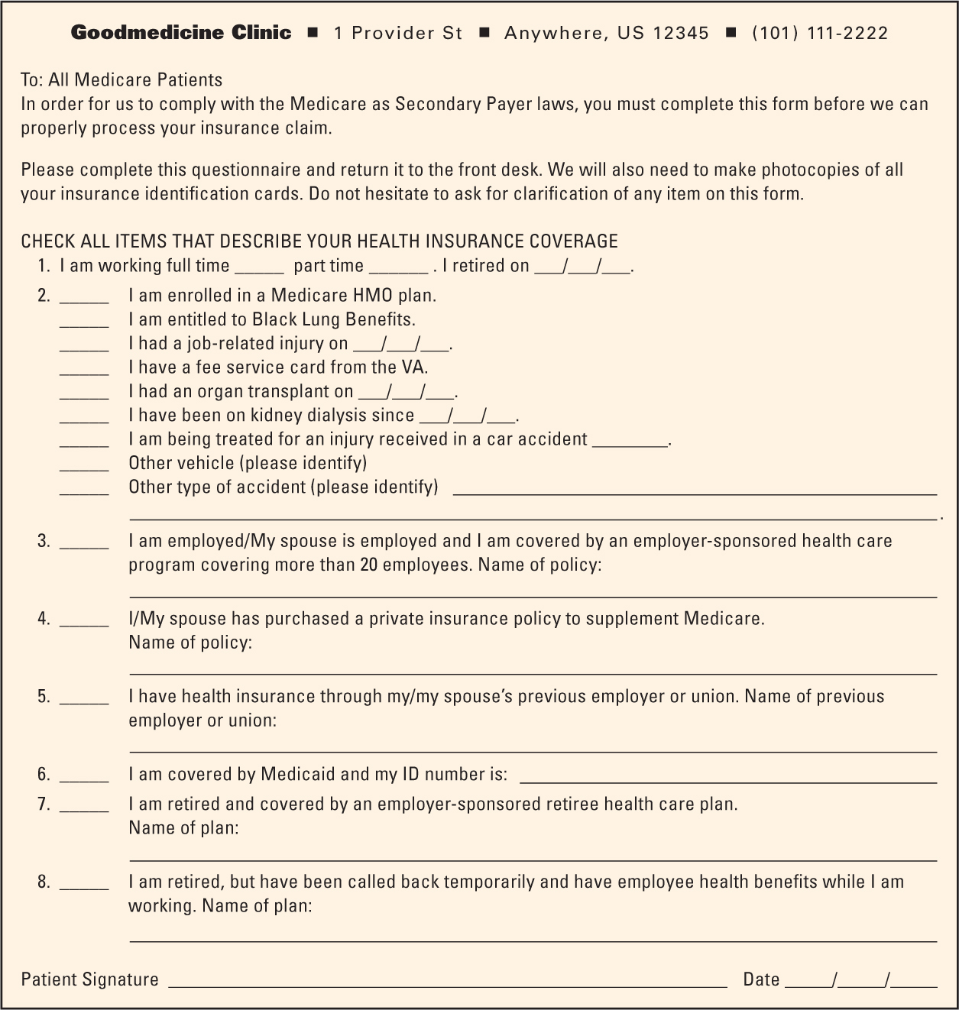
Medigap Plans

Slide 56
Participating Provider (PAR)
Provider accepts assignment on all claims submitted to Medicare and receives:
  Direct payment of all claims
  Faster processing of claims
Bonuses are provided to MACs for PAR enrollment.
Annual regional PAR directory (MedPARD) is published and made available to all Medicare patients.
(continues)

Slide 57
Participating Provider (PAR) (continued)
Special message is printed on unassigned Medicare Summary Notice (MSN) forms mailed to patients.
  Reminder of reduction in out-of-pocket expenses if
  PARs are used and stating how much they would save
Hospital referrals for outpatient care that:
  Provide patient with name and address of at least one PAR provider each time hospital provides referral for care.

Slide 58
Nonparticipating Provider
Abbreviated as nonPAR
May accept assignment on claim-by-claim basis, but restrictions must be followed:
  Must file all Medicare claims
  Fees are restricted to limiting charge.
  Balance billing of patient is forbidden.
  Collections are restricted to deductible and coinsurance.
  Patients sign Surgical Disclosure Notice (fees over $500).
  Must accept assignment on clinical laboratory charges

Slide 59
Limiting Charge
Maximum fee a nonPAR may charge for a covered service
Applies regardless of who is responsible for payment
Applies whether Medicare is primary or secondary
(continues)

Slide 60
Limiting Charge
(continued)
Medicare-allowed fee for nonPAR is
5 percent below PAR Medicare fee schedule.
NonPAR may charge maximum of 15 percent above the nonPAR approved rate (or 10 percent above PAR Medicare fee schedule).
This 15 percent allowance is based on 95 percent reduced Medicare fee schedule.
  Thus, nonPAR providers receive somewhat less than
  110 percent of allowed PAR amount.

Slide 61
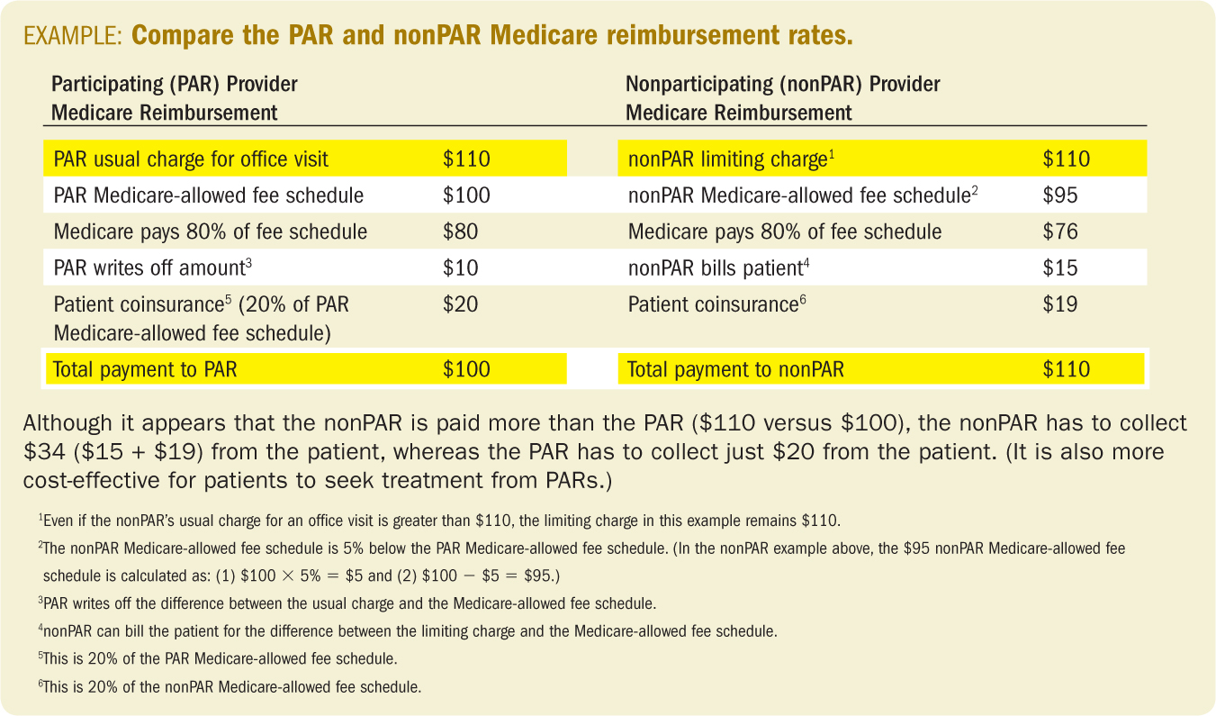
Example of Limiting Charge

Slide 62
Accepting Assignment
NonPAR who agrees to accept assignment on Medicare claim will be:
  Reimbursed Medicare-allowed fee
  Allowed to collect previously unpaid deductible and
  20 percent coinsurance determined from MPFS
  If entire charge is collected at patient encounter, assigned status is voided and nonPAR limiting fee is in effect.
    NonPAR may be subject to fine or in violation of MPFS requirements.
    NonPAR cannot revoke agreement for assigned claim unless by mutual written consent of provider and beneficiary.
(continues)

Slide 63
Accepting Assignment
(continued)
The following must accept assignment:
  Anesthesiologist assistants
  Certified nurse midwives
  Certified registered nurse anesthetists
  Clinical nurse specialists
  Clinical psychologists
  Clinical social workers
  Mass immunization roster billers
  Nurse practitioners
  Physician assistants
  Registered dietitians

Slide 64
Accepting Assignment
(continued)
Providers who submit claims for the following services must accept assignment:
  Ambulance services
  Ambulatory surgical center services
  Clinical diagnostic laboratory services
  Home dialysis supplies and equipment
  Medications
  Physician lab services
  Physician services to Medicare-Medicaid (Medi-Medi) crossover patients

Slide 65
Waiver of Medicare Billing Contracts
NonPARs are subject to sanctions, including fines and exclusions from Medicare program, if they:
  Require patients to sign agreements stating that the patient waives the right to have the nonPAR provider file the patient’s Medicare claims
  Require that the patient agrees to pay charges for services that are in excess of the nonPAR charge limits

Slide 66
Privacy Act of 1974
Forbids MACs from disclosing status of unassigned claim beyond the following:
  Date the claim was received by the MAC
  Date the claim was paid, denied, or suspended
  General reason the claim was suspended
NonPAR provider will not be told payment amounts or approved charge information.

Slide 67
Surgical Disclosure Notice
Providers must notify beneficiaries in writing about projected out-of-pocket expenses for:
  Elective surgery when the charge is $500 or more
  Noncovered procedures when the charge is $500 or more
Notification is required of both surgeons and assistant surgeons.
(continues)

Slide 68
Surgical Disclosure Notice
(continued)
For Medicare purposes, elective surgery is defined as a surgery that:
  Can be scheduled in advance
  Is not an emergency, and
  If delayed, would not result in death or permanent impairment of health

Slide 69
Surgical Disclosure Notice
(continued)
OBRA of 1986 requires the following written information to be provided to the patient:
  Estimated actual charge for surgery
  Estimated Medicare payment
  Excess of actual charge compared to approved charge
  Applicable coinsurance amount
  Beneficiary’s out-of-pocket expenses
Patient is required to sign/date a surgical disclosure notice.

Slide 70
Mandatory Claims Submission
Providers and suppliers must submit claims for Medicare-covered services if patient is enrolled in Medicare Part B.
This does not apply if the:
  Patient is not enrolled in Medicare Part B.
  Patient disenrolled before service was furnished.
  Patient refuses to sign authorization for release of info.
  Provider opts out of Medicare program, and patients enter into private contracts with provider.

Slide 71
Private Contracting
BBA of 1997 provided physicians with option of withdrawing from Medicare and entering into private contracts with Medicare patients.
Medicare private contract—agreement between Medicare beneficiary and physician
or other practitioner who has opted out of Medicare for two years:
  For all covered items and services that are furnished to Medicare beneficiaries
(continues)

Slide 72
Private Contracting
(continued)
Physician or other practitioner will not bill for any service or supplies provided to any Medicare beneficiary for at least two years.
Under a private contract:
  No Medicare payment will be made for services or procedures provided to a patient.
  Patient is required to pay whatever physician or other practitioner charges.

Slide 73
Private Contracting
(continued)
Under a private contract (continued):
  No limit on what physician or other practitioner can charge patient for Medicare-approved services
  Limiting charge does not apply.
  Medicare managed care plans will not pay for services rendered under a private contract.
  No claim is to be submitted to Medicare.
  Medicare will not pay if claim is submitted.

Slide 74
Private Contracting
(continued)
Under a private contract (continued):
  Supplemental insurance (Medigap) will not pay for services or procedures rendered.
  Other insurance plans may not pay for services or procedures rendered.

Slide 75
Advance Beneficiary Notice
Abbreviated as ABN
Written document provided to Medicare beneficiary by a supplier, physician, or provider prior to service being rendered
Indicates that service is unlikely to be reimbursed by Medicare
Specifies why Medicare denial is anticipated
(continues)

Slide 76
Advance Beneficiary Notice
(continued)
Requests beneficiary to sign agreement that guarantees personal payment for services
Beneficiary who signs ABN agreement will be held responsible for payment if Medicare denies payment.

Slide 77
Advance Beneficiary Notice
(continued)
Should be generated whenever supplier or provider believes a claim for the services is likely to receive a Medicare medical necessity denial
  Denial of otherwise covered services that were found to be not “reasonable and necessary”

Slide 78
Experimental and
Investigational Procedures
Medicare reimburses for services or supplies that are considered reasonable and necessary for the stated diagnosis.
Medicare will not cover procedures deemed to be experimental in nature.
(continues)

Slide 79
Experimental and
Investigational Procedures
(continued)
Provider must refund payment received from patient for service denied by Medicare as investigational, unnecessary, unproved, or experimental:
  Unless the patient agreed in writing prior to receiving services to personally pay for such services

Slide 80
Medicare as Primary Payer
Medicare is considered primary payer for the following circumstances:
  Employee is eligible for group health plan but has declined to enroll, or has recently dropped coverage.
  Individual is currently employed, but is not yet eligible for group plan coverage or has exhausted benefits.
  Health insurance plan is only for self-employed individuals.
  Health insurance plan was purchased as individual plan and not obtained through a group.
  Patient is also covered by TRICARE.
(continues)

Slide 81
Medicare as Primary Payer
(continued)
Medicare is considered primary payer for the following circumstances (continued):
  Patient is under age 65, has Medicare because of a disability or ESRD, and is not covered by employer-sponsored plan.
  Patient is under age 65, has ESRD, and has employer-sponsored plan but has been eligible for Medicare for more than 30 months.
  Patient left a company and elected to continue coverage in group health plan under COBRA rules.
  Patient has both Medicare and Medicaid (Medi-Medi crossover patient).

Slide 82
Medicare as Primary Payer
(continued)
COBRA of 1985 requires employers with 20 or more employees to allow employees and dependents to keep employer-sponsored group health insurance coverage for up to 18 months for:
  Death of employed spouse
  Loss of employment or reduction in work hours
  Divorce

Slide 83
Medicare as Primary Payer
(continued)
Employee or dependents may have to pay their share as well as employer’s share of premium.

Slide 84
Medicare Conditional
Primary Payer Status
Medicare awards assigned claim conditional primary payer status and processes claim when:
  Plan normally considered primary to Medicare issues denial of payment that is under appeal.
  Patient who is physically or mentally impaired fails to file a claim with primary payer.
(continues)

Slide 85
Medicare Conditional
Primary Payer Status
(continued)
Medicare awards assigned claim conditional primary payer status and processes claim when (continued):
  Workers’ compensation claim has been denied, and case is slowly moving through appeal process.
  There is no response from liability payer within 120 days of filing claim.

Slide 86
Medicare as Secondary Payer
Abbreviated as MSP
Medicare is secondary when
  Patient is eligible for Medicare and
  Patient is also covered by:
    EGHP that has more than 20 covered employees
    Disability coverage through EGHP that has more than 100
    covered employees
    ESRD case covered by EGHP of any size during first 18 months
    of patient’s eligibility for Medicare
(continues)

Slide 87
Medicare as Secondary Payer
(continued)
  Patient is also covered by (continued):
    Third-party liability policy, if Medicare-eligible person is
    seeking treatment for injury covered by policy
    Workers’ compensation program.
      If claim is contested, provider should file Medicare
      primary claim and include copy of workers’ compensation
      notice declaring that the case is “pending a Compensation
      Board decision.”

Slide 88
Medicare as Secondary Payer
(continued)
  Patient is also covered by (continued):
    Veterans Administration (VA) preauthorized services for
    a beneficiary who is eligible for both VA benefits and Medicare
    Federal Black Lung Program that covers currently or formerly
    employed coal miners

Slide 89
Medicare Summary Notice
Abbreviated as MSN
Easy-to-read, monthly statement that clearly lists health insurance claims information
Replaced the following:
  Explanation of Medicare Benefits (EOMB)
  Medicare Benefits Notice (Part A)
  Benefit denial letters

Slide 90
Billing Notes
Medicare Administrative Contractor
(MAC)—Regional MAC for traditional Medicare claims is selected by CMS through competitive bidding process.
Medicare Split/Shared Visit Payment
Policy—applies when physician and qualified nonphysician provider each perform substantive portion of medically necessary E/M service for same patient on same date of service
(continues)

Slide 91
Billing Notes
(continued)
Durable Medical Equipment Claims—must be sent to one of four regional MACs in the country
Deadline for Filing Claims—for regular Medicare and RRB claims is one calendar year from the date of service
Form Used—CMS-1500

Slide 92
Billing Notes
(continued)
Special Handling
  All providers are required to file Medicare claims for their patients.
  MSP—Copy of primary payer’s remittance advice must be attached to Medicare claim.

