Slide 1
Chapter 6
ICD-10-CM Coding

Slide 2
Classifications of Diseases with Similar Titles
ICD-10
ICD-9-CM
ICD-10-CM
ICD-10-PCS
Note: ICD-10-CM and ICD-10-PCS are abbreviated as ICD-10-CM/PCS.

Slide 3
ICD-9-CM Legacy Coding System
Used to archive data
Not supported/updated by ICD-9-CM Coordination and Maintenance Committee
GEMs—crosswalks of codes used to roughly identify ICD-10-CM codes for ICD-9-CM equivalent codes (and vice versa)

Slide 4
ICD-10-CM, ICD-10-PCS, CPT, and HCPCS Level II Codes
Provider Offices and Clinics | ICD-10-CM (diseases) CPT (procedures/services) HCPCS level II (services)
Hospital Inpatient | ICD-10-CM (diseases) ICD-10-PCS (procedures)
Hospital Outpatient | ICD-10-CM (diseases) CPT (procedures/services) HCPCS level II (services)

Slide 5
General Equivalency Mappings: Comparing ICD-9-CM to ICD-10-CM
ICD-9-CM Disease Code and Description | ICD-10-CM Disease Code and Description
003.21 Salmonella meningitis | A02.21 Salmonella meningitis
205.01 Acute myeloid leukemia in remission | C92.01 Acute myeloblastic leukemia in remission
649.51 Spotting complicating pregnancy, delivered, with or without mention of antepartum condition | O26.851 Spotting complicating pregnancy, first trimester O26.852 Spotting complicating pregnancy, second trimester O26.853 Spotting complicating pregnancy, third trimester O26.859 Spotting complicating pregnancy, unspecified trimester

Slide 6
Overview of ICD-10-CM and ICD-10-PCS
ICD-10-CM is clinical modification of WHO’s ICD-10.
ICD-10-CM is used to classify diseases for all health care settings.
ICD-10-PCS is used to classify inpatient hospital procedures only.

Slide 7
Purpose of ICD-10-CM and ICD-10-PCS
Decreases need to attach supporting documentation to claims
Enhances ability to conduct public health surveillance
Improves ability to measure health services

Slide 8
ICD-10-CM and ICD-10-PCS Provides Better Data for:
Conducting research/tracking public health
Designing payment systems
Identifying fraud and abuse
Making clinical decisions
Measuring care provided to patients
Processing claims

Slide 9
Physician Query Process
Ensures accurate ICD-10-CM/PCS coding
Process is activated when coder notices problem with documentation quality.
Coder requests clarification about documentation so accurate code can be assigned.

Slide 10
ICD-10-PCS Coding
Brand new classification developed by CMS
Used for inpatient hospital procedures only
Multiaxial seven-character alphanumeric codes (e.g., 047K04Z)
Provides unique codes for procedures.
Allows new procedures to be easily incorporated as new codes

Slide 11
Updating ICD-10-CM/PCS
ICD-10-CM/PCS Coordination and Maintenance Committee oversees changes and modifications.
Committee is comprised of:
CMS, NCHS, AHA, and AHIMA
Committee also discusses issues such as creation and update of GEMs.

Slide 12
Computer-Assisted Coding (CAC)
Uses natural language processing engine to “read” patient records and generate codes
Coders become coding auditors, responsible for ensuring accuracy of codes.
(continues)

Slide 13
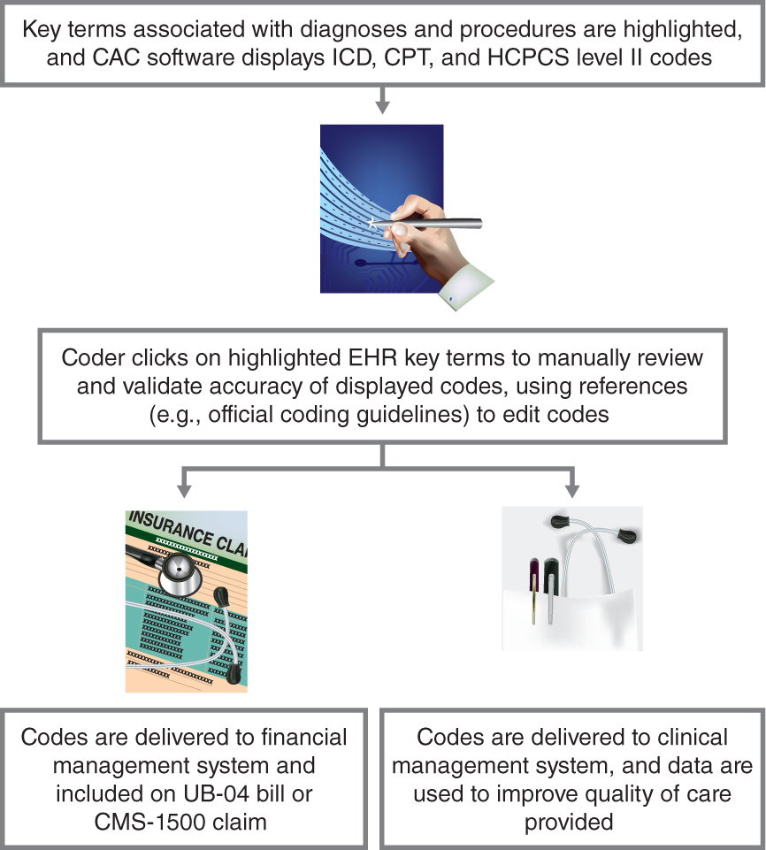
Computer-Assisted Coding (CAC) (continued)

Slide 14
Mandatory Reporting of ICD-10-CM and ICD-10-PCS
Medicare Catastrophic Coverage Act of 1988 mandated reporting of ICD-9-CM codes on Medicare claims.
Implementation of ICD-10-CM (diseases) and ICD-10-PCS (hospital inpatient procedures) codes mandates reporting of ICD-10-CM/PCS codes (instead of ICD-9-CM codes).

Slide 15
Medical Necessity
Determines the extent to which individuals with health conditions receive health care services
Reporting diagnosis codes (ICD-10-CM) ensures the medical necessity of procedures and services (CPT/HCPCS level II) provided to patients during an encounter.
(continues)

Slide 16
Medical Necessity (continued)
Medical necessity—determination that service/procedure rendered is reasonable and necessary for diagnosis or treatment of illness or injury
If scheduled tests, services, or procedures might be found medically unnecessary by Medicare, patient must sign advance beneficiary notice (ABN).

Slide 17
Medical Necessity (continued)
Encounter—face-to-face contact between patient and health care provider who assesses and treats patient’s condition
Thus, medical necessity is the measure of whether a health care procedure or service is appropriate for the diagnosis and/or treatment of a condition.

Slide 18
ICD-10-CM Coding Conventions
Format and typeface
Eponyms
Abbreviations
Punctuation
Tables
Includes notes
Excludes notes
Inclusion terms
Other, other specified, and unspecified codes
Etiology rules
Manifestation rules
And
Due to
With
Cross-references
See
See also
See category
See condition

Slide 19
Format and Typeface
ICD-10-CM index uses an indented format for ease in reference.
ICD-10-CM index subterms are indented two spaces.
Second and third qualifiers associated with the main term are further indented by two and four spaces, respectively.
(continues)

Slide 20
Format and Typeface (continued)
If an index entry requires more than one line, additional text is printed on the next line and indented five spaces.
In the ICD-10-CM tabular list, additional terms are indented below the term to which they are linked.

Slide 21
Format and Typeface (continued)
If a tabular list definition or disease requires more than one line, additional text is printed on next line and indented five spaces.
Boldface type is used for main term entries in the index.
Boldface type is used for all tabular list codes and descriptions of codes.

Slide 22
Format and Typeface (continued)
Italicized type is used for all tabular list exclusion notes.
Italicized type is used to identify manifestation codes, which are never reported as the first-listed diagnosis.

Slide 23
Eponyms
Eponym—disease or syndrome named for a person
Listed in alphabetical sequence as main terms in the index
Listed as subterms below main terms such as Disease or Syndrome
Tabular list usually includes eponym in code description.

Slide 24
Abbreviations
NEC (not elsewhere classifiable)
Means “other” or “other specified”
Identifies codes that are assigned when information needed to assign a more specific code cannot be located
NOS (not otherwise specified)
Equivalent of unspecified
Identifies codes that are to be assigned when information needed to assign a more specific code cannot be obtained from provider

Slide 25
Punctuation
Colon
Used after incomplete term or phrase in index and tabular list when one or more modifiers (additional terms) is needed to assign a code
Parentheses
Used in index and tabular list to enclose nonessential modifiers (supplementary words that may be present in or absent from physician statement of disease or procedure without affecting code number assigned)
(continues)

Slide 26
Punctuation (continued)
Slanted brackets
Used in index to identify manifestation codes
Used in index and tabular list to enclose abbreviations, synonyms, alternative wording, or explanatory phrases
Manifestation
Condition that occurs as the result of another condition
Manifestation codes are always reported as secondary codes.
Code and description may or may not appear in italics in tabular list.

Slide 27
Tables
Table of Neoplasms—alphabetical index of anatomic sites that categorize tumors as:
Malignant primary
Malignant secondary
Malignant in situ
Benign
Of uncertain behavior
Of unspecified nature
(continues)

Slide 28
Tables (continued)
Table of Drugs and Chemicals—alphabetical index of medicinal, chemical, and biological substances that result in poisonings and adverse effects
Categories in Table of Drugs and Chemicals
Poisoning: Accidental (Unintentional) | Poisoning: Undetermined
Poisoning: Intentional Self-harm | Adverse Effect
Poisoning: Assault | Underdosing

Slide 29
Includes Notes, Excludes Notes, and Inclusion Terms
Includes Note—appears in tabular lists below certain categories to define, clarify, or give examples of the content of a code category
Excludes1 Note—“pure” excludes
Means “Not coded here”
Indicates mutually exclusive codes
Two conditions that cannot be reported together
(continues)

Slide 30
Includes Notes, Excludes Notes, and Inclusion Terms (continued)
Excludes2 Note
Means “not included here”
Indicates that, although excluded condition is not classified as part of condition excluded from, a patient might be diagnosed with all conditions at the same time
When Excludes2 note appears under a code, it may be acceptable to assign both the code and the excluded code(s) together if supported by documentation.

Slide 31
Includes Notes, Excludes Notes, and Inclusion Terms (continued)
Inclusion Terms
Located below certain codes in the tabular list
Indicate some conditions for which that code number may be assigned
May be synonyms of the code title
For other specified codes, inclusion terms provide list of conditions included within a classification code.
Lists of inclusion terms in tabular lists is not exhaustive— Refer to index for additional terms.

Slide 32
Other, Other Specified, and Unspecified Codes
Other and other specified codes
Assigned when documentation provides detail for which specific code does not exist in ICD-10-CM
Index entries that contain NEC are classified to “other” codes in tabular list.
Index entries represent specific disease entities for which no specific code exists in the tabular list, so the term is included within an “other” code.
(continues)

Slide 33
Other, Other Specified, and Unspecified Codes (continued)
Unspecified codes
Assigned when documentation is insufficient
Ask provider to document additional information.
When tabular list category does not contain unspecified code, an other specified code may represent both other and unspecified.
Other and unspecified category and subcategory codes require assignment of extra character(s) to classify condition.

Slide 34
Etiology and Manifestation Rules
Code first underlying disease.
Code first underlying disease, such as
Code, if applicable, any causal condition first.
Use additional code.
In diseases classified elsewhere

Slide 35
And
And as contained in tabular list category titles and code descriptions means and/or.
Example: Subcategory code H61.0, Chondritis and perichondritis of external ear, is interpreted as:
Chondritis of external ear
Perichondritis of external ear
Chondritis and perichondritis of external ear

Slide 36
Due To
Located in index, in alphabetical order below main term
Indicates presence of cause-and-effect relationship between two conditions
When index includes due to as subterm, code is assigned only if physician documented causal relationship between two conditions.

Slide 37
In
Located in index, in alphabetical order below main term
Indicates presence of cause-and-effect relationship between two conditions
To assign a code from the list of qualifiers below the word in, physician must document both conditions.

Slide 38
With
Located in index, immediately below main term
Means associated with or due to
To assign a code from the list of qualifiers below the word with, physician must document both conditions.

Slide 39
Cross-References
See
Located after index main term
Directs coder to refer to another index term to locate code
Coder must go to the referenced main term to locate correct code.
(continues)

Slide 40
Cross-References (continued)
See also
Located after index main term or subterm
Directs coder to another main term (or subterm) that may provide additional useful index entries
Does not have to be followed if original main term (or subterm) provides correct code

Slide 41
Cross-References (continued)
See category
Directs coder to tabular list, where code can be selected from the options provided
See condition
Directs coder to main term for condition
Found in disease index

Slide 42
ICD-10-CM Index to Diseases and Injuries
Alphabetical listing of terms and corresponding codes, which include:
Specific illnesses
Injuries
Eponyms
Abbreviations
Other descriptive diagnostic terms

Slide 43
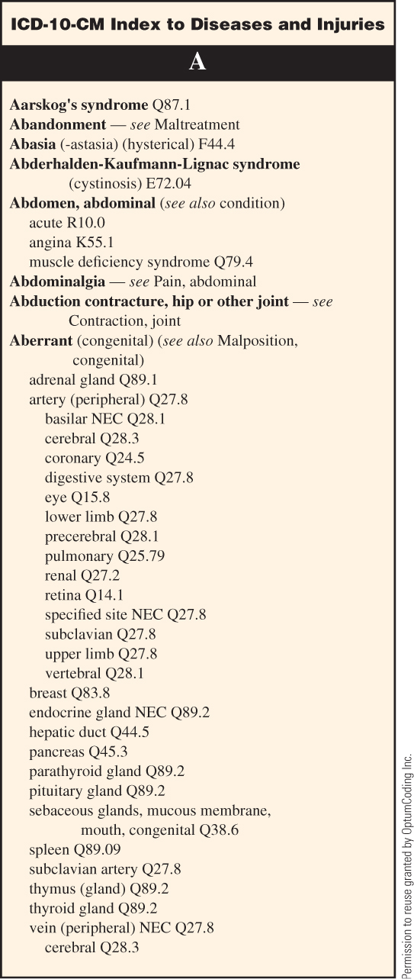
ICD-10-CM Index to Diseases and Injuries (partial listing)

Slide 44
Main Terms
Boldfaced
Listed in alphabetical order
Hyphens within main terms are ignored.
Single space within a main term is not ignored.
(continues)

Slide 45
Main Terms (continued)
Nonessential qualifiers
Supplementary words located in parentheses after main term
Do not have to be included in diagnostic statement for code to be assigned
Qualifiers
Supplementary terms
Further modify subterms and other qualifiers

Slide 46
Subterms
Also called essential modifiers
Qualify main term by listing alternative sites, etiology, and clinical status
Indented two spaces under main term
Second qualifiers are indented two spaces under subterm.
(continues)

Slide 47
Subterms (continued)
Third qualifiers are indented two spaces under second qualifier.
Fourth qualifiers are indented two spaces under third qualifier.
When moving from bottom of one column to top of next, main term will be repeated and followed by—continued.

Slide 48
Display of ICD-10-CM Index Main Terms, Subterms, and Qualifiers
Start of Main Term in Index to Diseases and Injuries |  |  |  |  |  | Continuation of Main Term (next column)
Main term: | Stricture (see also Stenosis) |  |  |  |  | Main term: | Stricture — continued
Subterm: |  | aqueduct of Sylvius (congenital) Q03.0 |  |  |  | Subterm: |  | bronchus J98.09
Second qualifier: |  |  | with spina bifida —see spina bifida, |  |  | Second qualifier: |  |  | congenital Q32.3
Continuation line: |  |  |  |  | by site, with hydrocephalus | Second qualifier: |  |  | syphilitic A52.72
Third qualifier: |  |  |  | acquired G91.1 |  | Subterm: |  | cardia (stomach) K22.2

Slide 49
Table of Neoplasms
Neoplasms are tumors in which cell reproduction is out of control.
Providers specify whether tumor is:
Benign (noncancerous)
Malignant (cancerous)
Invasive (spreads to other parts of body)
Refer to pathology report for clarification of diagnosis.
(continues)

Slide 50
Table of Neoplasms (continued)
Lesion—discontinuity of tissue, which may or may not be malignant
Index entries for lesion contain subterms according to anatomic site.
Term lesion is referenced only if diagnostic statement does not confirm malignancy.

Slide 51
Table of Neoplasms (continued)
Following conditions are examples of benign lesions and are listed as index main terms:
Adenosis
Cyst
Dysplasia
Mass
NOTE: If neoplasm is used in diagnostic statement, refer to Table of Neoplasms (not index entry for mass).
Polyp

Slide 52
Table of Neoplasms (continued)
Indexed by anatomic site
Neoplasm classifications:
Primary malignancy
Secondary malignancy
Carcinoma in situ
Benign
Uncertain behavior
Unspecified nature

Slide 53
Table of Neoplasms (portion)

Slide 54
Primary Malignancy
Malignancy is coded as primary site if diagnosis documents:
Metastatic from a site
Spread from a site
Primary neoplasm of a site
Malignancy for which no specific classification is documented
Recurrent tumor

Slide 55
Secondary Malignancy
Described as metastatic
Indicates that primary cancer has spread (metastasized) to another part of body
Sequencing of neoplasm codes depends on whether primary or secondary cancer is being:
Managed
Treated
(continues)

Slide 56
Secondary Malignancy (continued)
Cancer described as metastatic from a site is primary of that site.
Assign one code to primary neoplasm.
Assign second code to:
Secondary neoplasm of the specified site (if secondary site is known)
Unspecified site (if secondary site is unknown)

Slide 57
Secondary Malignancy (continued)
Cancer described as metastatic to a site is considered secondary of that site.
Assign one code to secondary site.
Assign second code to:
Specified primary site (if primary site is known)
Unspecified site (if primary site is unknown)

Slide 58
Secondary Malignancy (continued)
When anatomic sites are documented as metastatic:
Assign secondary neoplasm code(s) to those sites.
Assign unspecified site code to primary malignant neoplasm.

Slide 59
Secondary Malignancy (continued)
If diagnostic statement does not specify whether neoplasm site is primary or secondary, code site as primary.
Unless documented site is bone, brain, diaphragm, heart, liver, lymph nodes, mediastinum, meninges, peritoneum, pleura, retroperitoneum, or spinal cord
The above sites are considered secondary sites unless the physician specifies that they are primary.

Slide 60
Anatomic Site Is Not Documented
If cancer diagnosis does not contain documentation of the anatomic site, but the
term metastatic is documented
Assign codes for unspecified site for both primary and secondary sites.

Slide 61
Primary Malignant Site Is No Longer Present
If primary site of malignancy is no longer present:
Do not assign the code for “primary of unspecified site”.
Instead, classify previous primary site by assigning appropriate code from category Z85 (Personal history of malignant neoplasm).

Slide 62
Contiguous or Overlapping Sites
Contiguous sites
Also called overlapping sites
Occur when origin of tumor (primary site) involves two adjacent sites
Neoplasms with overlapping site boundaries are classified to fourth-digit subcategory .8, Other.

Slide 63
Re-excision of Tumors
Occurs when pathology report recommends surgeon perform second excision to widen margins of original tumor site
Ensures all tumor cells were removed
Ensures clear border (margin) of normal tissue surrounding excised specimen
(continues)

Slide 64
Re-excision of Tumors (continued)
Use diagnostic statement found in report of original excision to code reason for re-excision.
Pathology report for re-excision may not specify malignancy, but patient is still under treatment for original neoplasm.

Slide 65
Table of Drugs and Chemicals
Alphabetical index of medicinal, chemical, and biological substances that result in poisonings and adverse effects
First column lists generic names of drugs and chemicals.
Next six columns classify poisonings, adverse effects, and underdosing.
(continues)

Slide 66
Table of Drugs and Chemicals (continued)
Six columns of codes included for:
Poisoning: accidental (unintentional)
Poisoning: intentional (self-harm)
Poisoning: assault
Poisoning: undetermined
Adverse effect
Underdosing

Slide 67
Table of Drugs and Chemicals (portion)

Slide 68
Index to External Causes
Arranged in alphabetical order by main term to indicate event
Secondary codes for use in any health care setting
Intended to provide data for injury research and evaluation of injury prevention strategies
(continues)

Slide 69
Index to External Causes (continued)
Assigned to capture:
Cause of injury
Activity being performed
Place of occurrence
Status at the time of injury

Slide 70
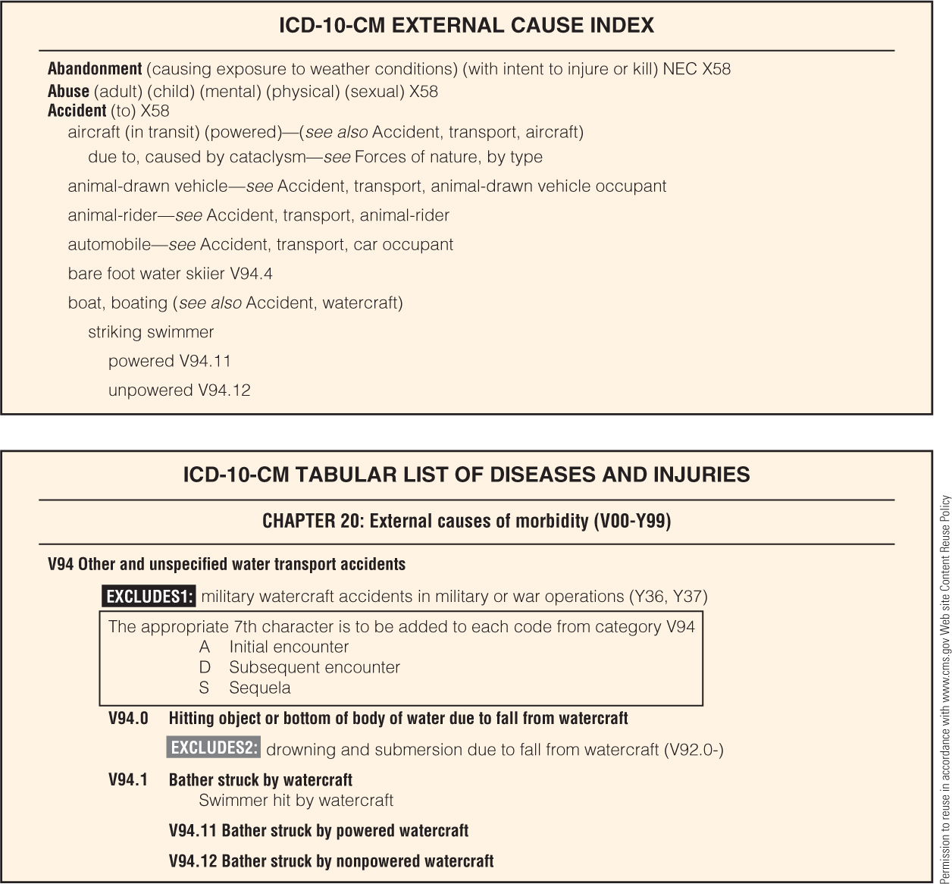
Index to External Causes (continued)

Slide 71
Using the Index to Diseases and Injuries
Locate main term in index.
If instructional phrase—See condition is found after main term, descriptive term or anatomic site has been mistakenly referenced instead of disorder or disease documented in diagnostic statement.
(continues)

Slide 72
Using the Index to Diseases and Injuries (continued)
When condition in diagnostic statement is not easily found in index, use main terms below to locate code.

Slide 73
Using the Index to Diseases and Injuries (continued)
Sometimes terms found in index are not found in tabular list when code number is reviewed for verification.
Trust the index—concept that there are more terms listed in index than in tabular list, so “trust the index” and go to the code indicated

Slide 74
ICD-10-CM Tabular List of Diseases and Injuries
Chronological list of codes contained within 21 chapters
Based on body system or condition
Organized within:
Major topic headings
Categories, subcategories, and codes

Slide 75
Structure of ICD-10-CM Codes
Three-character categories
Four-, five-, or six-character subcategories
Four-, five-, six-, or seven-character codes, which contain letters and numbers
Each level of subdivision within a category is called a subcategory.
Final level of subdivision is a code.

Slide 76
Use of ICD-10-CM Codes for Reporting Purposes
Only codes are permissible, not categories or subcategories.
Any applicable seventh character is required.
(continues)

Slide 77
Use of ICD-10-CM Codes for Reporting Purposes (continued)
Placeholder character
ICD-10-CM utilizes character “x” as fifth-character placeholder for certain six-character codes.
Allows for future expansion without disturbing six-character structure (e.g., H62.8x1)
When a placeholder exists, the x must be entered for the code to be considered a valid code.

Slide 78
Use of ICD-10-CM Codes for Reporting Purposes (continued)
Seventh characters
Certain categories contain applicable seventh characters.
Required for all codes within category (or as instructed by notes in tabular list)
Seventh character must always be located in seventh-character data field.
If code that requires a seventh character is not six characters in length, placeholder x is entered to fill in the empty character.

Slide 79
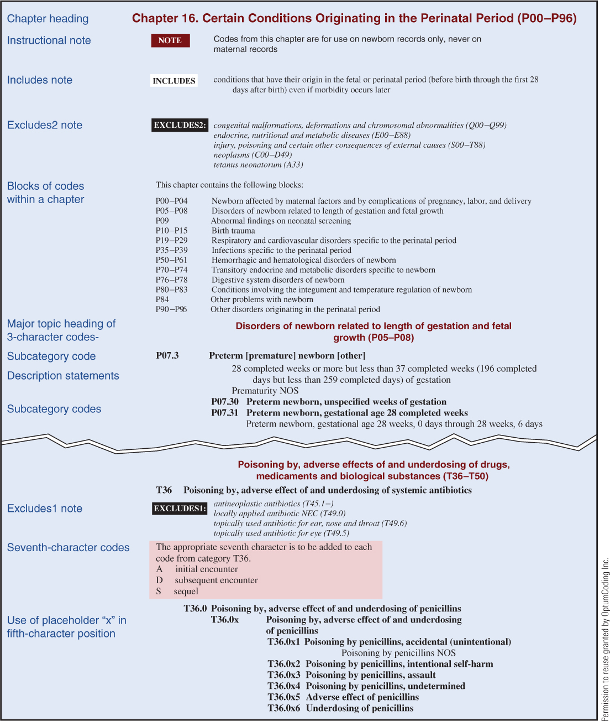
ICD-10-CM Tabular List of Diseases and Injuries (sample)

Slide 80
ICD-10-CM External Cause Codes
The following are incorporated into
ICD-10-CM tabular list:
Injury, Poisoning, and Certain Other Consequences of External Causes (Chapter 19) (S and T codes)
External Causes of Morbidity (Chapter 20) (V–Y codes)
Reported for:
Environmental events
Industrial accidents
Injuries inflicted by criminal activity
(continues)

Slide 81
ICD-10-CM External Cause Codes (continued)
External cause codes do not directly impact reimbursement to provider.
However, such codes can expedite insurance claims processing.
External cause codes indicate circumstances related to an injury.

Slide 82
Factors Influencing Health Status and Contact with Health Services
Incorporated into tabular list
Located in Chapter 21 (Z codes) (Z00-Z99)
Last chapter of the ICD-10-CM tabular list
Codes are reported for patient encounters when circumstance other than disease or injury is documented (e.g., well-child visit).

Slide 83
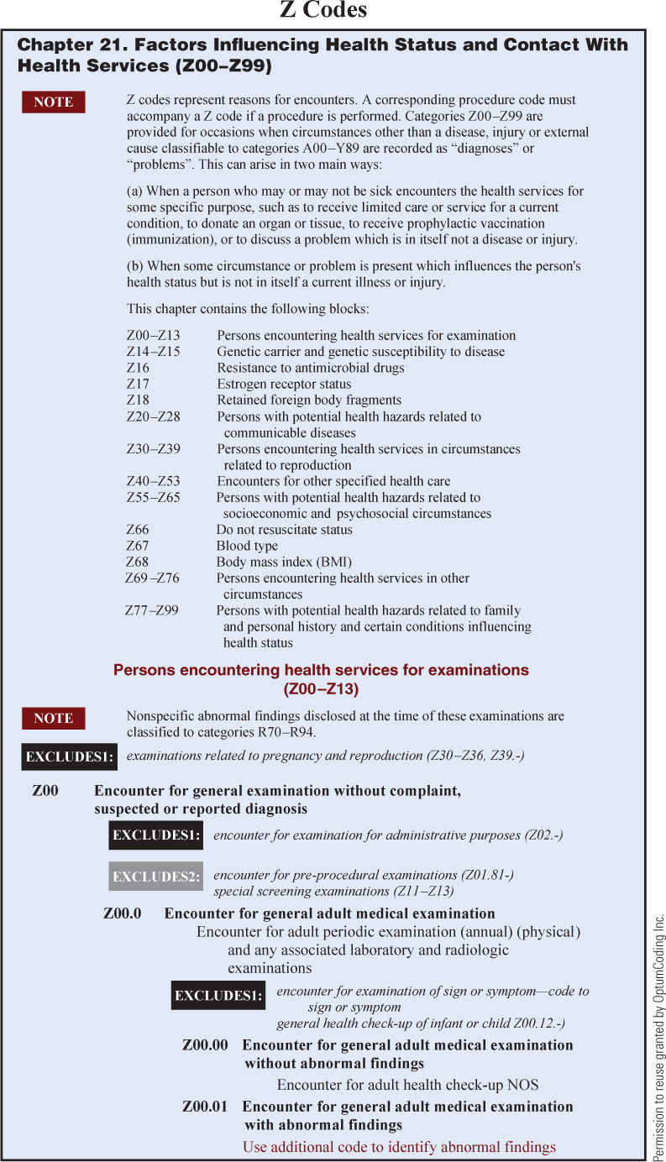
ICD-10-CM Tabular List of Diseases and Injuries (Z codes)

Slide 84
Morphology of Neoplasm Codes
Morphology—tissue type of neoplasm
EXAMPLES: adenocarcinoma, sarcoma
Not reported on insurance claims
Reported to state cancer registries
ICD-O-3 is used to assign morphology codes.
(continues)

Slide 85
Morphology of Neoplasm Codes (continued)
Contain five digits, preceded by letter M
Range is from M8000/0 to M9989/3.
First four digits (e.g., M8000) indicate specific histologic term.

Slide 86
Morphology of Neoplasm Codes (continued)
Fifth digit, after slash, is behavior code.
Indicates whether tumor is:
Malignant
Benign
In situ
Uncertain whether malignant or benign
Separate one-digit code is assigned for histologic grading to indicate differentiation.

Slide 87
ICD-10-CM/PCS Official Guidelines for Coding and Reporting
Prepared by CMS and NCHS
Approved by Cooperating Parties for ICD-10-CM and ICD-10-PCS, which include:
CMS, NCHS, AHA, and AHIMA
Rules that accompany ICD-10-CM/PCS coding conventions and instructions
(continues)

Slide 88
ICD-10-CM/PCS Official Guidelines for Coding and Reporting (continued)
Joint effort between the health care provider and the coder is essential for complete and accurate:
Documentation
Code assignment
Reporting of diagnoses and procedures

Slide 89
ICD-10-CM/PCS Official Guidelines for Coding and Reporting (continued)
Official guidelines use the terms:
Encounter—indicates all health care settings, including inpatient hospital admissions
Provider—refers to physicians and qualified health care practitioners who are legally accountable for establishing the patient’s diagnosis

Slide 90
ICD-10-CM/PCS Official Guidelines for Coding and Reporting (continued)
ICD-10-CM official guidelines organized as:
Section I: Conventions, general coding guidelines, and chapter-specific guidelines
Section II: Selection of principal diagnosis
Section III: Reporting additional diagnoses
Section IV: Diagnostic coding and reporting guidelines for outpatient services
Appendix I: Present on admission reporting guidelines

Slide 91
ICD-10-CM/PCS Official Guidelines for Coding and Reporting (continued)
ICD-10-PCS official guidelines are organized according to:
Conventions
Medical and surgical section guidelines
Obstetrics section guidelines

Slide 92
ICD-10-CM Diagnostic Coding and Reporting Guidelines for Outpatient Services
Selection of first-listed condition
Codes from A00–T88, Z00–Z99
Accurate reporting of ICD-10-CM codes
Codes that describe signs and symptoms
(continues)

Slide 93
ICD-10-CM Diagnostic Coding and Reporting Guidelines for Outpatient Services (continued)
Codes that describe signs and symptoms
Encounters for circumstances other than a disease or injury (Z codes)
Level of detail in coding

Slide 94
ICD-10-CM Diagnostic Coding and Reporting Guidelines for Outpatient Services (continued)
ICD-10-CM code for diagnosis, condition, problem, or other reason for encounter/visit
Uncertain diagnoses
Qualified diagnoses—suspected, questionable, rule out, or working diagnosis, or other similar terms indicating uncertainty

Slide 95
ICD-10-CM Diagnostic Coding and Reporting Guidelines for Outpatient Services (continued)
Chronic diseases
Code all documented conditions that coexist
Patients receiving diagnostic services only

Slide 96
ICD-10-CM Diagnostic Coding and Reporting Guidelines for Outpatient Services (continued)
Patients receiving therapeutic services only
Patients receiving preoperative evaluations only
Ambulatory surgery

Slide 97
ICD-10-CM Diagnostic Coding and Reporting Guidelines for Outpatient Services (continued)
Routine outpatient prenatal visits
Encounters for general medical examinations with abnormal findings
Encounters for routine health screenings

